Slide 1
Numerical Solution of an Equation
Method Of False Position

Slide 2
Content
History, Problem and Objective
Derivation of Formula
Iteration Process Example
Advantages and Disadvantages of Method of False Position
Error Analysis
Real Life Application

Slide 3
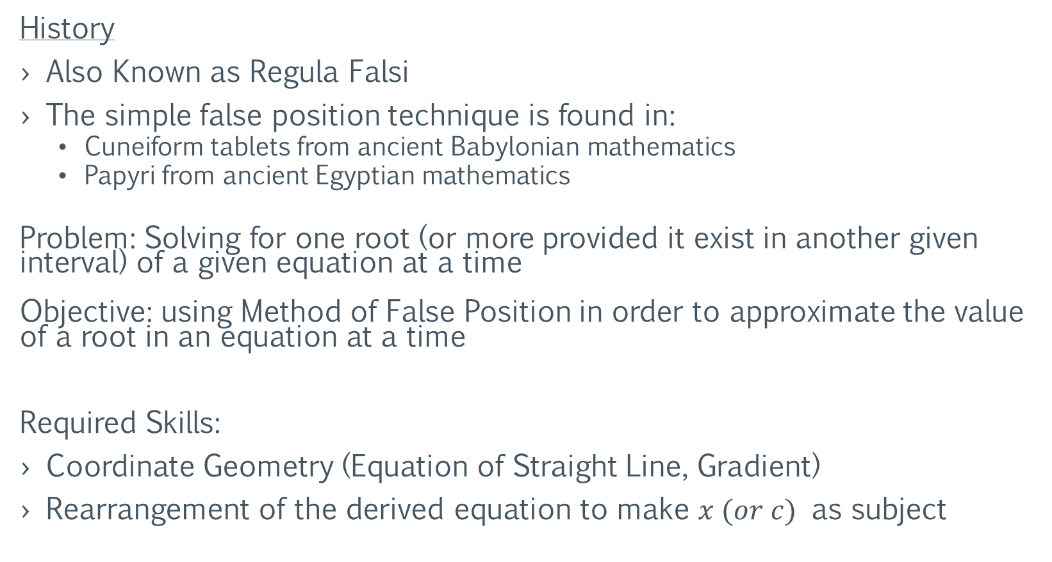
History, Problem and Objective
History
Also Known as Regula Falsi
The simple false position technique is found in:
Cuneiform tablets from ancient Babylonian mathematics
Papyri from ancient Egyptian mathematics
Problem: Solving for one root (or more provided it exist in another given interval) of a given equation at a time Objective: using Method of False Position in order to approximate the value of a root in an equation at a time
Required Skills:
Coordinate Geometry (Equation of Straight Line, Gradient)
Rearrangement of the derived equation to make $x (or c)$ as subject

Slide 4
Derivation Of Method of False Position

Slide 5



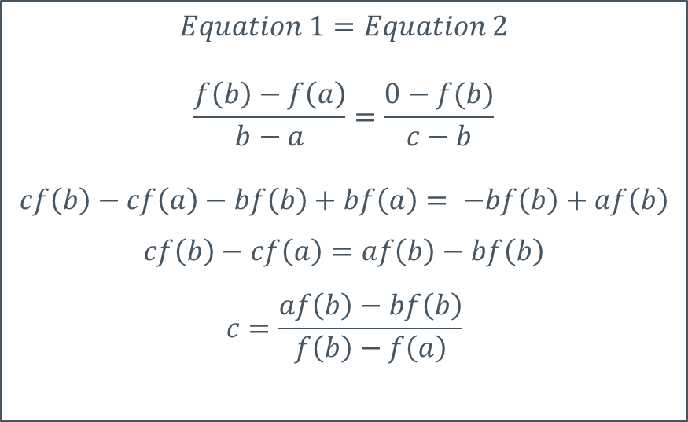


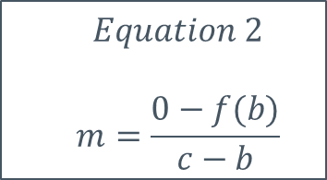

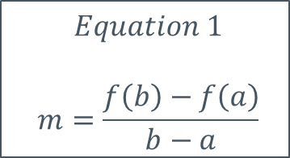


Derivation
Gradient of Line Is Given By $$m= \frac{y_{2}−y_{1}}{x_{2}−x_{1}}$$
Graph
$$f(x)$$
$$Equation 1$$ $$m=\frac{f\left(b\right)−f\left(a\right)}{b−a}$$
$$Equation 2$$ $$m=\frac{0−f(b)}{c−b}$$
$$\left(b , f\left(b\right)\right)$$
$$\left(c , f\left(c\right)\right)$$
$$Equation 1=Equation 2$$
$$\frac{f\left(b\right)−f\left(a\right)}{b−a}=\frac{0−f(b)}{c−b}$$
$$cf\left(b\right)−cf\left(a\right)−bf\left(b\right)+bf\left(a\right)= −bf\left(b\right)+af\left(b\right)$$
$$cf\left(b\right)−cf\left(a\right)=af\left(b\right)−bf\left(b\right)$$
$$c=\frac{af\left(b\right)−bf\left(b\right)}{f\left(b\right)−f\left(a\right)}$$
$$x$$
$$0$$
$$\left(c , 0\right)$$
$$(a , f\left(a\right))$$

Slide 6
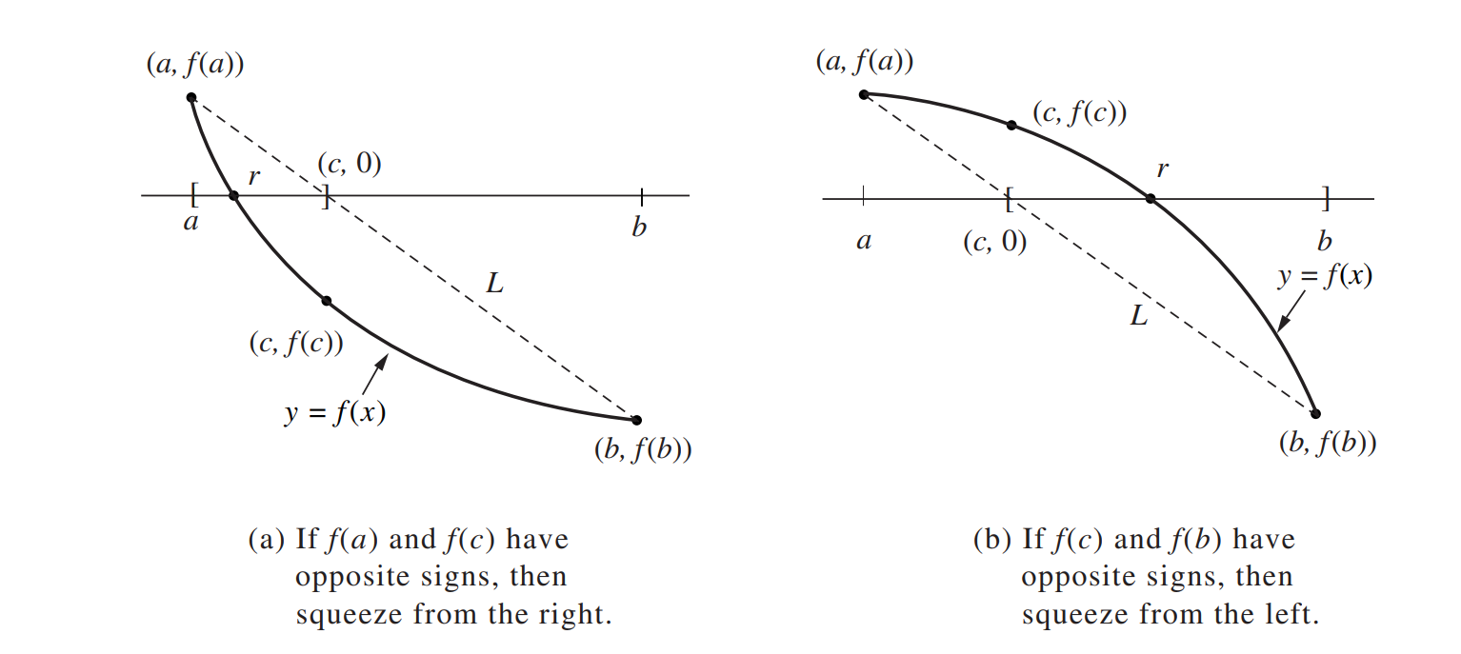
2 Situations
https://iq.opengenus.org/regula-falsi-method/

Slide 7
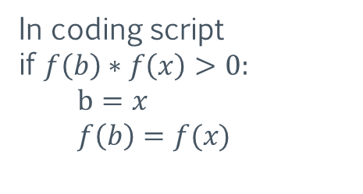
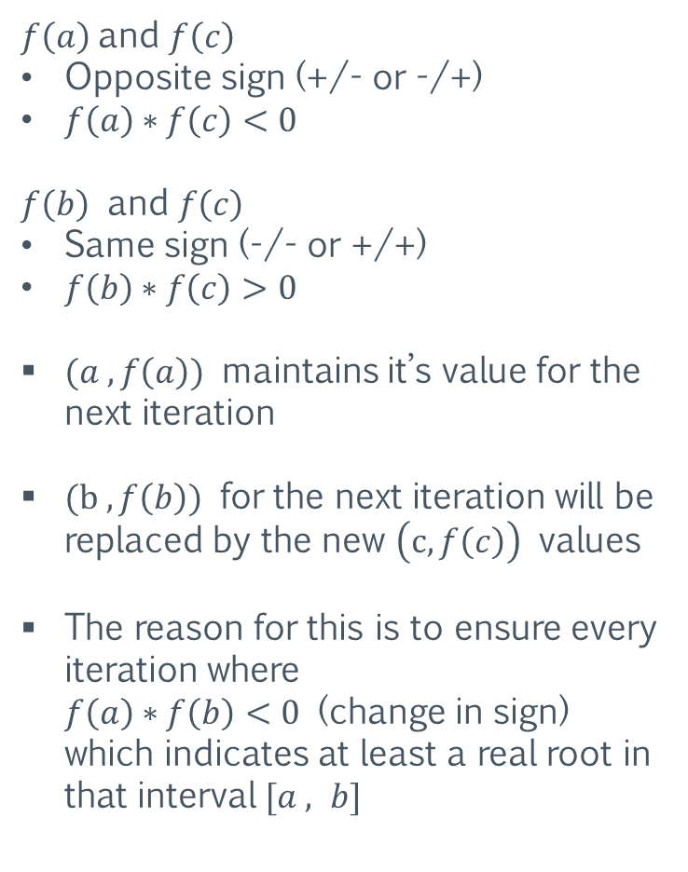
Animation of Situation (a) – Squeeze From Right
https://www.youtube.com/watch?v=pg1I8AG59Ik
$f\left(a\right)$and $f\left(c\right)$
Opposite sign (+/- or -/+)
$f\left(a\right)∗f\left(c\right)<0$
$f\left(b\right)$ and $f\left(c\right)$
Same sign (-/- or +/+)
$f\left(b\right)∗f\left(c\right)>0$
$(a , f\left(a\right))$ maintains it’s value for the next iteration
$(b , f\left(b\right))$ for the next iteration will be replaced by the new $\left(c, f\left(c\right)\right)$ values
The reason for this is to ensure every iteration where $f\left(a\right)∗f\left(b\right)<0$ (change in sign) which indicates at least a real root in that interval $[a , b]$
In coding script
if $f\left(b\right)∗f\left(x\right)>0:$
$$b=x$$
$$f\left(b\right)=f(x)$$

Slide 8

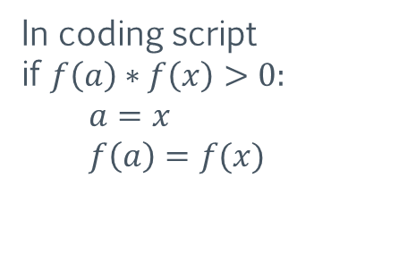
Animation of Situation (b) – Squeeze From Left
https://iq.opengenus.org/regula-falsi-method/
$f\left(b\right)$and $f\left(c\right)$
Opposite sign (+/- or -/+)
$f\left(b\right)∗f\left(c\right)<0$
$f\left(a\right)$ and $f\left(c\right)$
Same sign (-/- or +/+)
$f\left(a\right)∗f\left(c\right)>0$
$(b , f\left(b\right))$ maintains it’s value for the next iteration
$(a , f\left(a\right))$ for the next iteration will be replaced by the new $\left(c, f\left(c\right)\right)$ values
The reason for this is to ensure every iteration where $f\left(a\right)∗f\left(b\right)<0$ (change in sign) which indicates at least a real root in that interval $[a , b]$
In coding script
if $f\left(a\right)∗f\left(x\right)>0:$
$$a=x$$
$$f\left(a\right)=f(x)$$

Slide 9
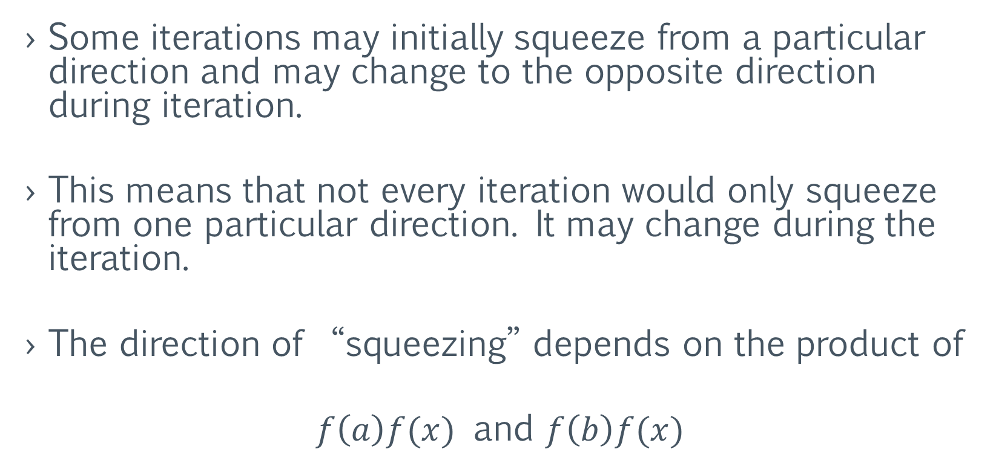
Additional Information
Some iterations may initially squeeze from a particular direction and may change to the opposite direction during iteration.
This means that not every iteration would only squeeze from one particular direction. It may change during the iteration.
The direction of “squeezing” depends on the product of
$f\left(a\right)f(x)$ and $f\left(b\right)f(x)$

Slide 10
Iteration Process Example

Slide 11
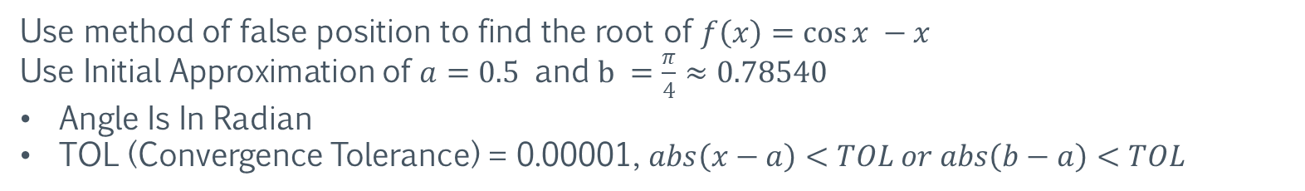
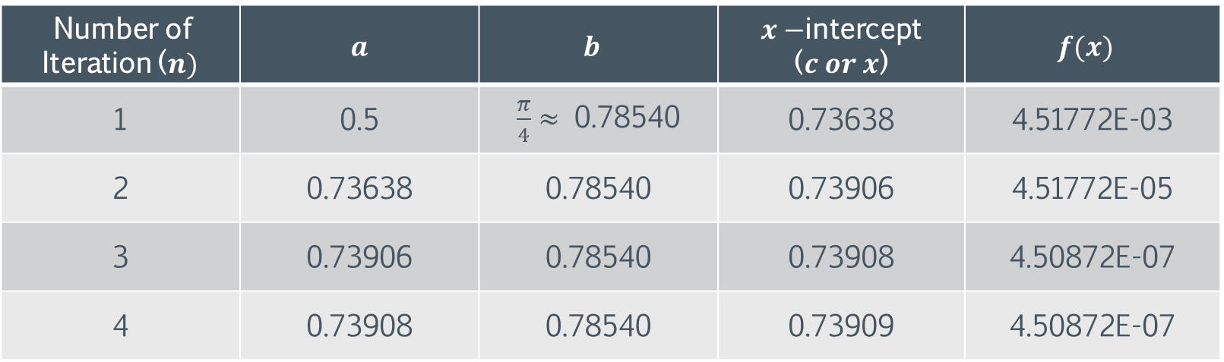

Iteration Result Table
Formula For Iteration: $c=\frac{af\left(b\right)−bf\left(b\right)}{f\left(b\right)−f\left(a\right)}$
Use method of false position to find the root of $f\left(x\right)=cos{x −x}$ Use Initial Approximation of $a=0.5$ and $b =\frac{π}{4}≈0.78540$
Angle Is In Radian
TOL (Convergence Tolerance) = 0.00001, $abs\left(x−a\right)<TOL or abs\left(b−a\right)<TOL$
Number of Iteration ($n)$ | $a$ | $$b$$ | $x−$intercept ($c or x$) | $$f(x)$$
1 | 0.5 | $\frac{π}{4}≈$ 0.78540 | 0.73638 | 4.51772E-03
2 | 0.73638 | 0.78540 | 0.73906 | 4.51772E-05
3 | 0.73906 | 0.78540 | 0.73908 | 4.50872E-07
4 | 0.73908 | 0.78540 | 0.73909 | 4.50872E-07
Squeeze From Left Situation
Note: 4.50872E-07 = 0.000000450872
Constant

Slide 12
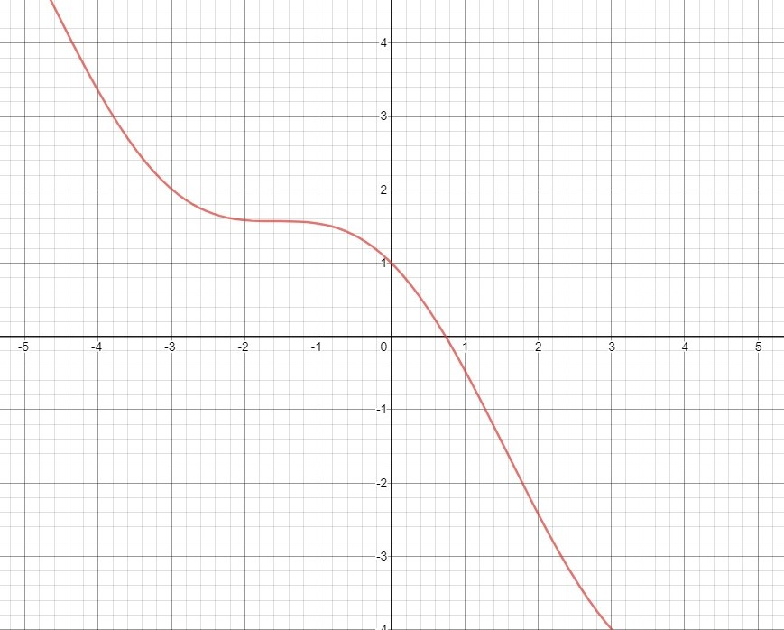

Graph of $f\left(x\right)=cos{x −x}$
https://www.desmos.com/calculator

Slide 13
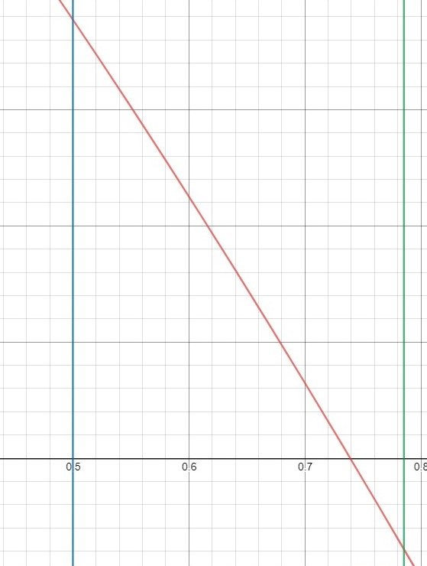
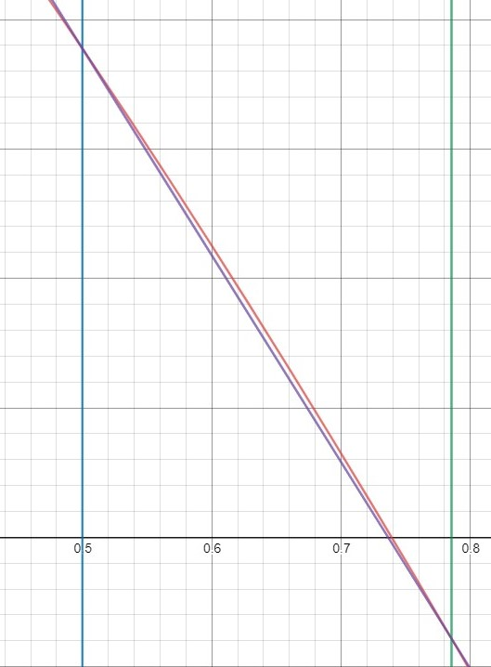
https://www.desmos.com/calculator
Graph showing the 2 initial values
Graph showing the line connecting 2 initial values (Purple)

Slide 14










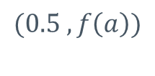
Visual Graph
Zoom The Graph Around The Area of $0.5$ to $\frac{π}{4}$
$$(a , f\left(a\right))$$
$$f\left(x\right)=cos{x −x}$$
$$f(x)$$
$$(0.5 , f\left(a\right))$$
Actual Root, x
$$\left(c , f\left(c\right)\right)$$
$$x$$
$$0$$
$$\left(c , 0\right)$$
$$\left(\frac{π}{4}, f\left(b\right)\right)$$
$$\left(b , f\left(b\right)\right)$$
Squeeze From Left Situation

Slide 15
Advantages of Method of False Position
No differentiation is needed like Newton-Raphson method
It will surely converge as the x-intercept always lie in the given interval, provided the initial value given is valid

Slide 16
Disadvantages
If equation has more than one roots, we would need to choose different intervals and recalculate
False-position can be slow like a function below

Slide 17
Real Life Application

Slide 18
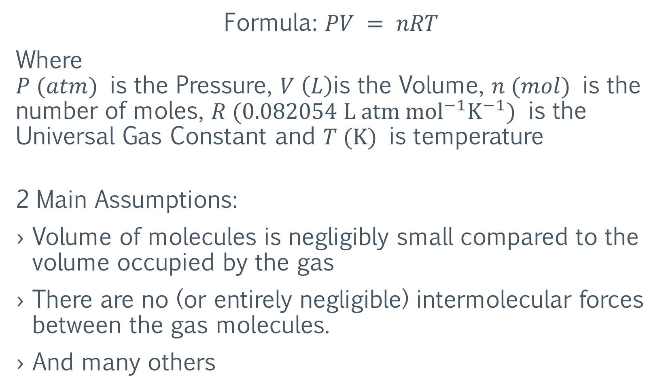
Ideal Gas Law
https://www.chemguide.co.uk/physical/kt/idealgases.html#:~:text=The%20assumptions%20are%3A,the%20walls%20of%20the%20container.
Formula: $PV = nRT$
Where $P (atm)$ is the Pressure, $V \left(L\right)$is the Volume, $n (mol)$ is the number of moles, $R (0.082054 L atm {mol}^{−1}K^{−1})$ is the Universal Gas Constant and $T (K)$ is temperature
2 Main Assumptions:
Volume of molecules is negligibly small compared to the volume occupied by the gas
There are no (or entirely negligible) intermolecular forces between the gas molecules.
And many others

Slide 19
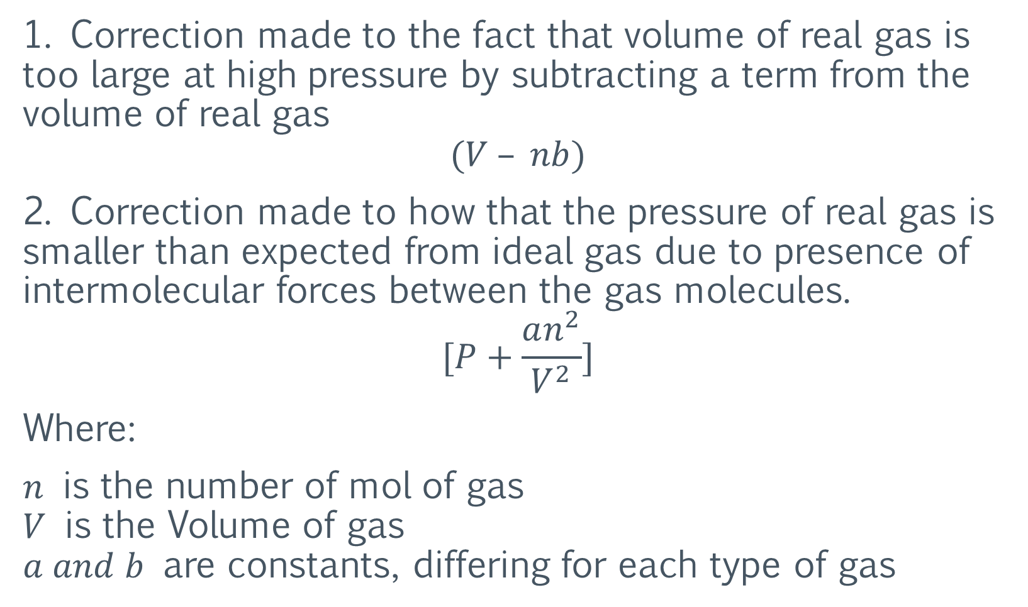
Deviation from Ideal Gas Law
http://chemed.chem.purdue.edu/genchem/topicreview/bp/ch4/deviation5.html#:~:text=The%20ideal%20gas%20equation%20is,PV%20should%20be%20a%20constant.
1. Correction made to the fact that volume of real gas is too large at high pressure by subtracting a term from the volume of real gas
$$(V – nb)$$
2. Correction made to how that the pressure of real gas is smaller than expected from ideal gas due to presence of intermolecular forces between the gas molecules.
$$[P+\frac{an^{2}}{V^{2}}]$$
Where:
$n$ is the number of mol of gas $V$ is the Volume of gas $a and b$ are constants, differing for each type of gas

Slide 20
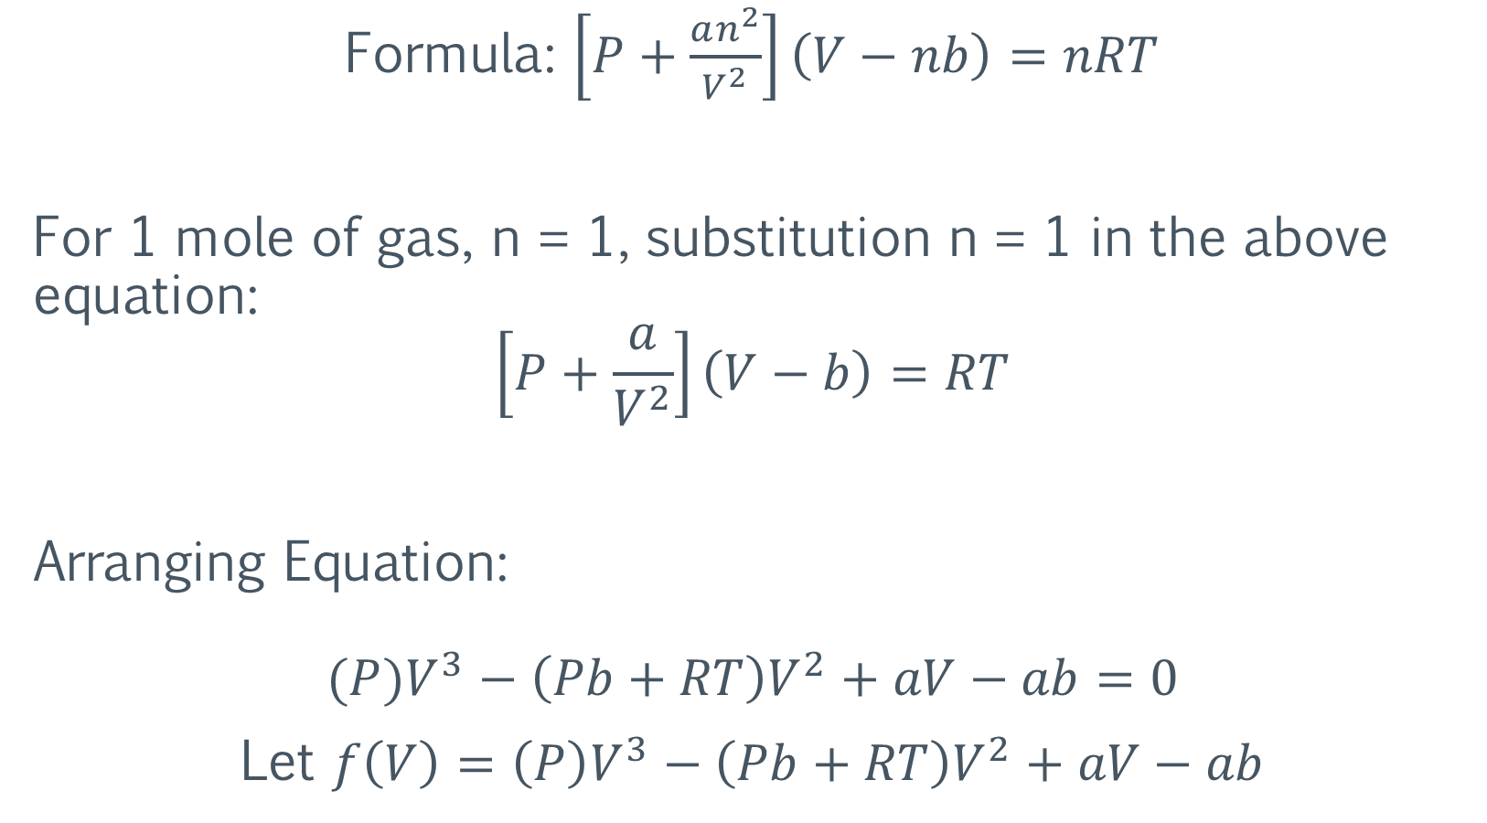
Van der Waals Equation
http://chemed.chem.purdue.edu/genchem/topicreview/bp/ch4/deviation5.html#:~:text=The%20ideal%20gas%20equation%20is,PV%20should%20be%20a%20constant.
Formula: $\left[P+\frac{an^{2}}{V^{2}}\right]\left(V−nb\right)=nRT$
For 1 mole of gas, n = 1, substitution n = 1 in the above equation:
$$\left[P+\frac{a}{V^{2}}\right]\left(V−b\right)=RT$$
Arranging Equation:
$$(P)V^{3}−\left(Pb+RT\right)V^{2}+aV−ab=0$$
Let $f\left(V\right)=\left(P\right)V^{3}−\left(Pb+RT\right)V^{2}+aV−ab$

Slide 21

Situation
A chemical engineering design project requires that you accurately estimate the molar volume ($V$) of oxygen for a number for a temperature of ($300 K$) and pressure combinations (1 and 100 $atm$) so that appropriate containment vessels can be selected.
$$R= 0.082054 L atm {mol}^{−1}K^{−1}$$ for oxygen: $a=1.360$ for oxygen: $b=0.03183$
Substituting values into equation for pressure of $1 atm$ and $100 atm$
$$\left(1\right)V^{3}−\left(\left[1\right]\left[0.03183\right]+\left[0.082054\right]\left[300\right]\right)V^{2}+\left[1.360\right]\left[V\right]−\left[1.360\right]\left[0.03183\right]$$
$$V^{3}−24.9345V^{2}+1.360V −0.050928=0$$
$$\left(100\right)V^{3}−\left(\left[100\right]\left[0.03183\right]+\left[0.082054\right]\left[300\right]\right)V^{2}+\left[1.360\right]\left[V\right]−\left[1.360\right]\left[0.03183\right]$$
$${100V}^{3}−27.7992V^{2}+1.360V −0.050928=0$$

Slide 22

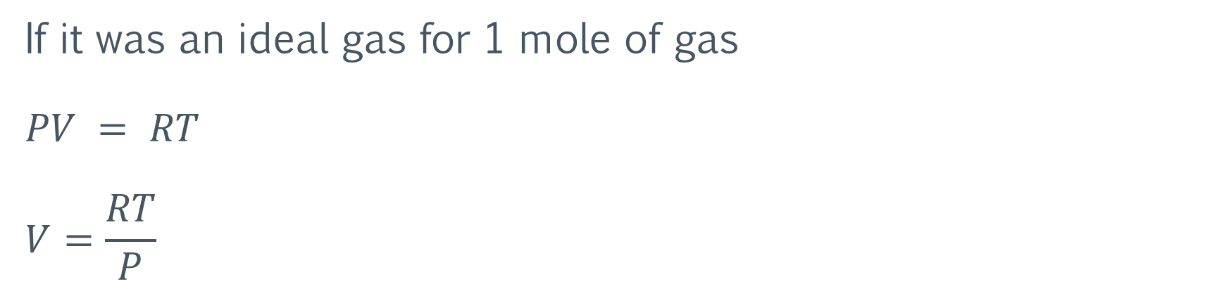
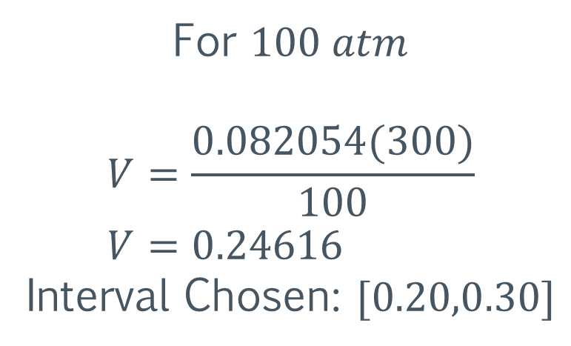
Situation
If it was an ideal gas for 1 mole of gas $$PV = RT$$ $$V=\frac{RT}{P}$$
For $1 atm$ $$V=\frac{0.082054(300)}{1} \\ V=24.6162$$ Interval Chosen: $\left[20,30\right]$
For $100 atm$ $$V=\frac{0.082054(300)}{100} \\ V=0.24616$$
Interval Chosen: $[0.20,0.30]$
*Ensure Interval Chosen Results in Change In Sign

Slide 23
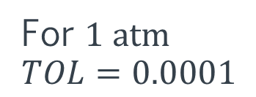
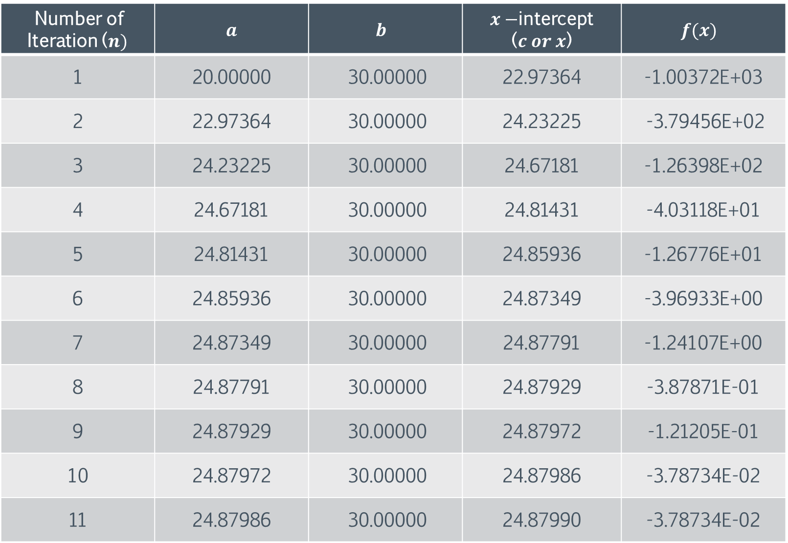
For $1 atm$ $TOL=0.0001$
Number of Iteration ($n)$ | $a$ | $$b$$ | $x−$intercept ($c or x$) | $$f(x)$$
1 | 20.00000 | 30.00000 | 22.97364 | -1.00372E+03
2 | 22.97364 | 30.00000 | 24.23225 | -3.79456E+02
3 | 24.23225 | 30.00000 | 24.67181 | -1.26398E+02
4 | 24.67181 | 30.00000 | 24.81431 | -4.03118E+01
5 | 24.81431 | 30.00000 | 24.85936 | -1.26776E+01
6 | 24.85936 | 30.00000 | 24.87349 | -3.96933E+00
7 | 24.87349 | 30.00000 | 24.87791 | -1.24107E+00
8 | 24.87791 | 30.00000 | 24.87929 | -3.87871E-01
9 | 24.87929 | 30.00000 | 24.87972 | -1.21205E-01
10 | 24.87972 | 30.00000 | 24.87986 | -3.78734E-02
11 | 24.87986 | 30.00000 | 24.87990 | -3.78734E-02

Slide 24
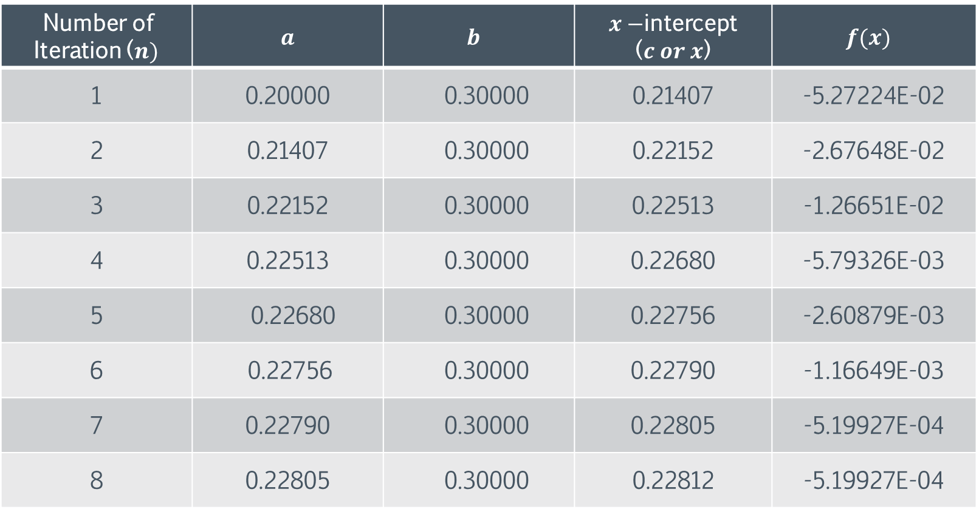
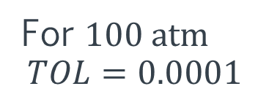
For $100 atm$ $$TOL=0.0001$$
Number of Iteration ($n)$ | $a$ | $$b$$ | $x−$intercept ($c or x$) | $$f(x)$$
1 | 0.20000 | 0.30000 | 0.21407 | -5.27224E-02
2 | 0.21407 | 0.30000 | 0.22152 | -2.67648E-02
3 | 0.22152 | 0.30000 | 0.22513 | -1.26651E-02
4 | 0.22513 | 0.30000 | 0.22680 | -5.79326E-03
5 | 0.22680 | 0.30000 | 0.22756 | -2.60879E-03
6 | 0.22756 | 0.30000 | 0.22790 | -1.16649E-03
7 | 0.22790 | 0.30000 | 0.22805 | -5.19927E-04
8 | 0.22805 | 0.30000 | 0.22812 | -5.19927E-04

Slide 25
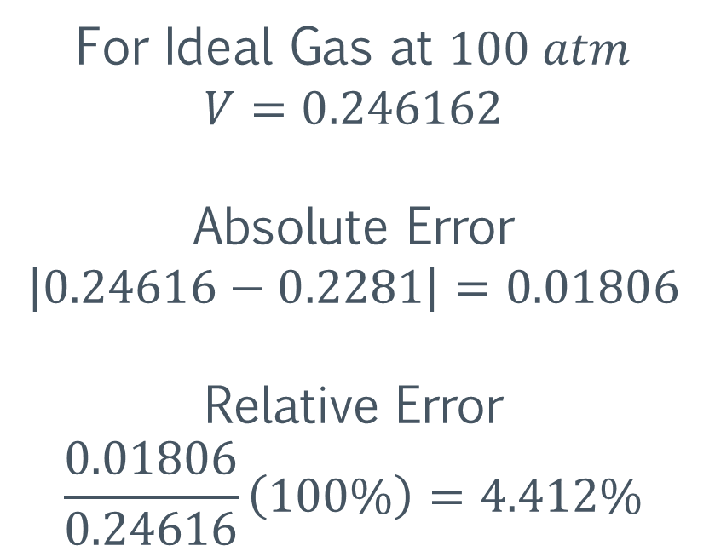
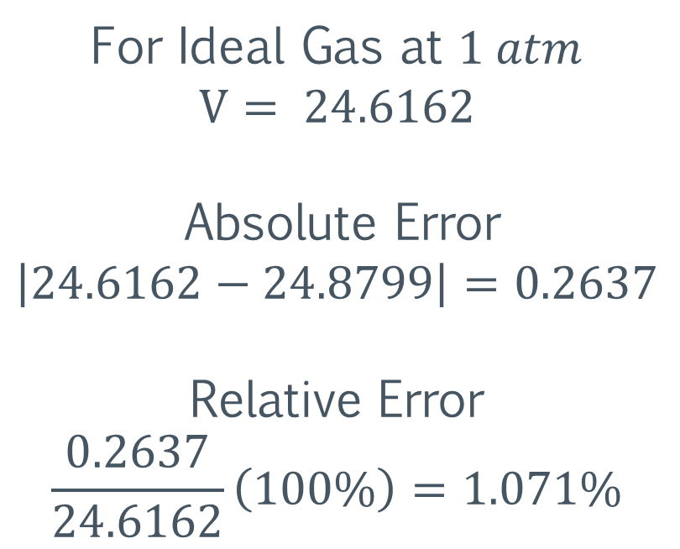
Absolute and Relative Error
For Ideal Gas at $1 atm$ $$V= 24.6162$$ Absolute Error $$\left|24.6162−24.8799\right|=0.2637$$
Relative Error $$\frac{0.2637}{24.6162}\left(100\%\right)=1.071\%$$
For Ideal Gas at $100 atm$
$$V=0.246162$$
Absolute Error $$\left|0.24616−0.2281\right|=0.01806$$
Relative Error
$$\frac{0.01806}{0.24616}\left(100\%\right)=4.412\%$$

Slide 26
Other Real Life Usage
https://regulafalsi.fandom.com/wiki/Application#:~:text=Modification%20of%20the%20Regula%20Falsi,found%20in%20industrial%20point%20sources.
Modification of the Regula Falsi method to accelerate system convergence in the prediction of trace quantities of atmospheric pollutants.
Prediction of trace quantities of air pollutants produced by combustion reactions such as those found in industrial point sources.
Equilibrium quantities of not combusted fuel generally are quite small, due to the exothermic nature of combustion reactions. Accordingly, calculating the theoretical maximum efficiency (Carnot Efficiency) which may be achieved in a combustion process is difficult since the equations describing the equilibrium state are stiff.

Slide 27
END OF PRESENTATION

